Slide 1
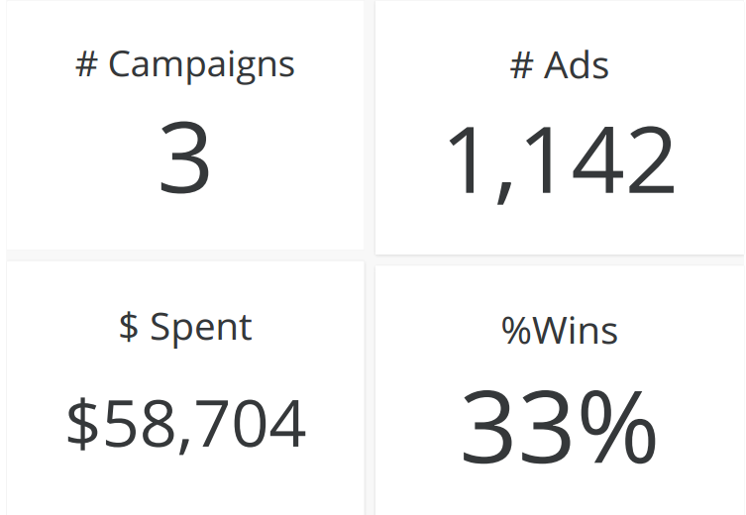
Advertisement Campaign Use Case
ADD ID | CAMPAIGN ID | FB CAMPAIGN ID | AGE | GENDER | INTEREST | IMPRESSION | CLICKS | SPENT | TOTAL CONVERSIONS | APPROVED CONVERSIONS
708749 | 916 | 103917 | 30-34 | M | 16 | 17861 | 2 | 1.82000002 | 2 | 0
708771 | 916 | 103920 | 30-34 | M | 20 | 693 | 0 | 0 | 1 | 0
708815 | 916 | 103928 | 30-34 | M | 28 | 4259 | 1 | 1.25 | 1 | 0
708818 | 916 | 103928 | 30-34 | M | 28 | 4133 | 1 | 1.28999996 | 1 | 1
708820 | 916 | 103929 | 30-34 | M | 29 | 1915 | 0 | 0 | 1 | 1
708889 | 916 | 103940 | 30-34 | M | 15 | 15615 | 3 | 4.76999998 | 1 | 0
708895 | 916 | 103941 | 30-34 | M | 16 | 10951 | 1 | 1.26999998 | 1 | 1
708953 | 916 | 103951 | 30-34 | M | 27 | 2355 | 1 | 1.5 | 1 | 0
708958 | 916 | 103952 | 30-34 | M | 28 | 9502 | 3 | 3.15999997 | 1 | 0
708979 | 916 | 103955 | 30-34 | M | 31 | 1224 | 0 | 0 | 1 | 0
Descriptive Analytics
Notes:
Based on the available add campaign data , you can view typical information which has been extracted to know what happened during the campaign. This is an example of Descriptive Analytics , to know how well the sales were realized in total vs per campaign. Based on this finding we can see , the campaign id 1178 has highest realized sales

Slide 2
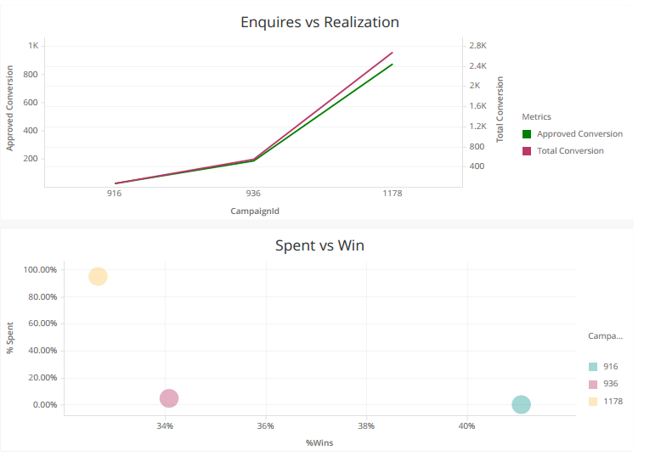
Diagnostic Analytics
CampaignId | %Wins | % Spent
916 | 41% | 0.25%
936 | 34% | 4.93%
1178 | 33% | 94.82%
Gender | % Spent
F | 58.77%
M | 41.23%
Notes:
As you can see here few data explorations have been made and it has been identified that %Wins are lesser even though dollars spent is quite high. One of the interesting fact shown here is that minimum spent is at the highest win.
Similarly it has been noticed that campaign spent has been done higher for females rather than male customers.
We can further drill down to check what happened in cases where highest spent but lesser wins.

Slide 3
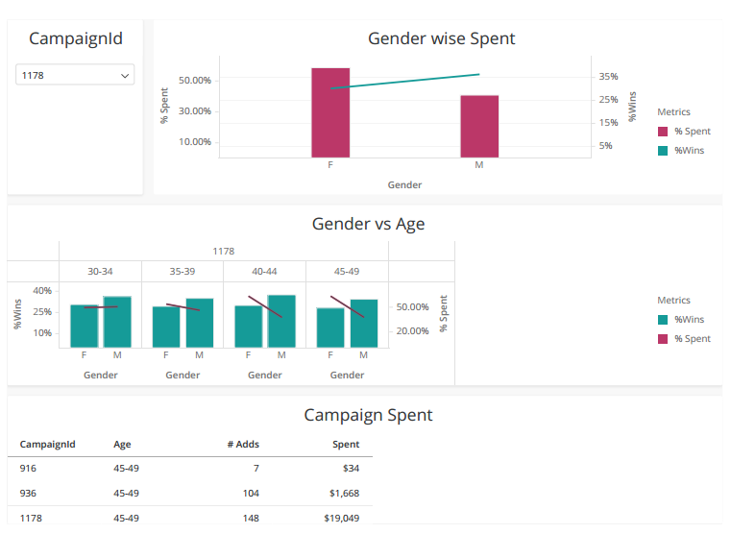
Campaign Analysis

Slide 4
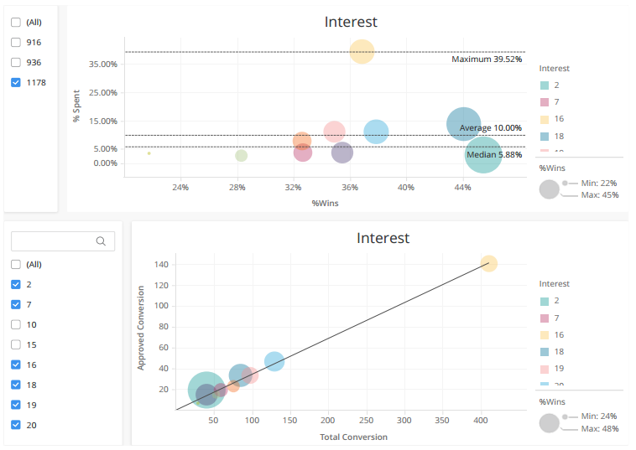
Customer Interest

Slide 5
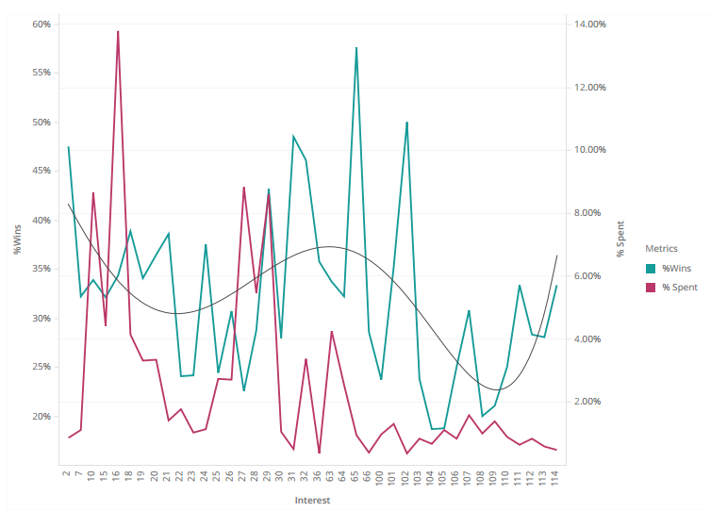
Customer Interest

